Slide 1
Surviving the Grand National
A story from the trenches

Slide 2
The Grand National
9th April 2016
Notes:
The Grand National is the biggest horse race of the UK horse racing season.
It's part of Aintree festival, which isn't the largest festival (it's not as big as Cheltenham), but it's the one race in the UK that everyone bets on even they don't bet on horse races.
It's unique, it's an anomaly, and it makes the most traffic which a betting website sees all year.

Slide 3
Some Grand National facts…
Started in 1839
Nearly 7km long (4 miles 514 yards)
30 fences jumped, over 2 laps
Highest prized jump-race in Europe
Up to 40 horses
The favourite has only won 9 times in the last 70 years
Highest bet traffic of the year

Slide 4
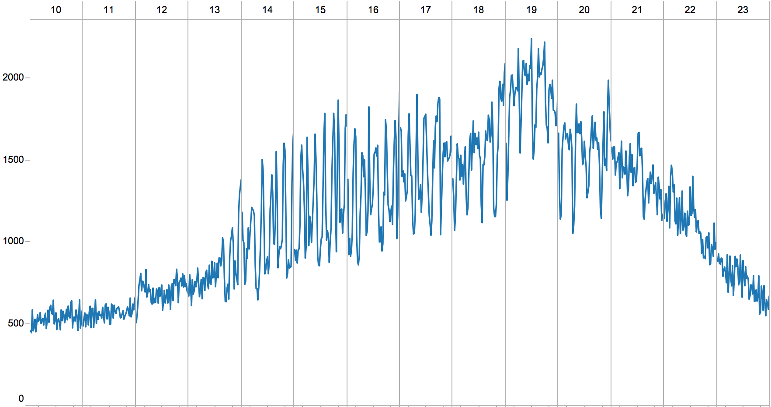
A normal weekday
Notes:
Notice the horse racing “spikiness” from 2pm – 9pm ish.
Now we’ll scale that down…

Slide 5
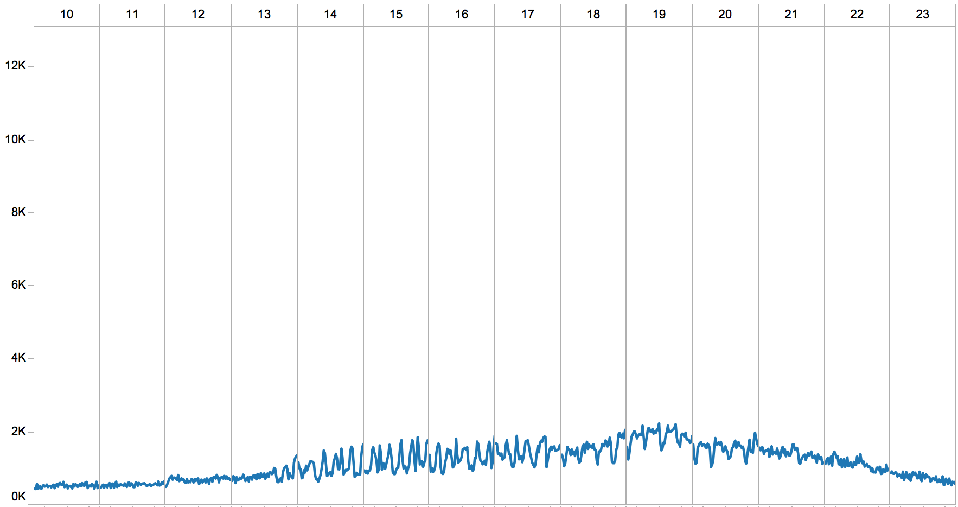
A normal weekday

Slide 6
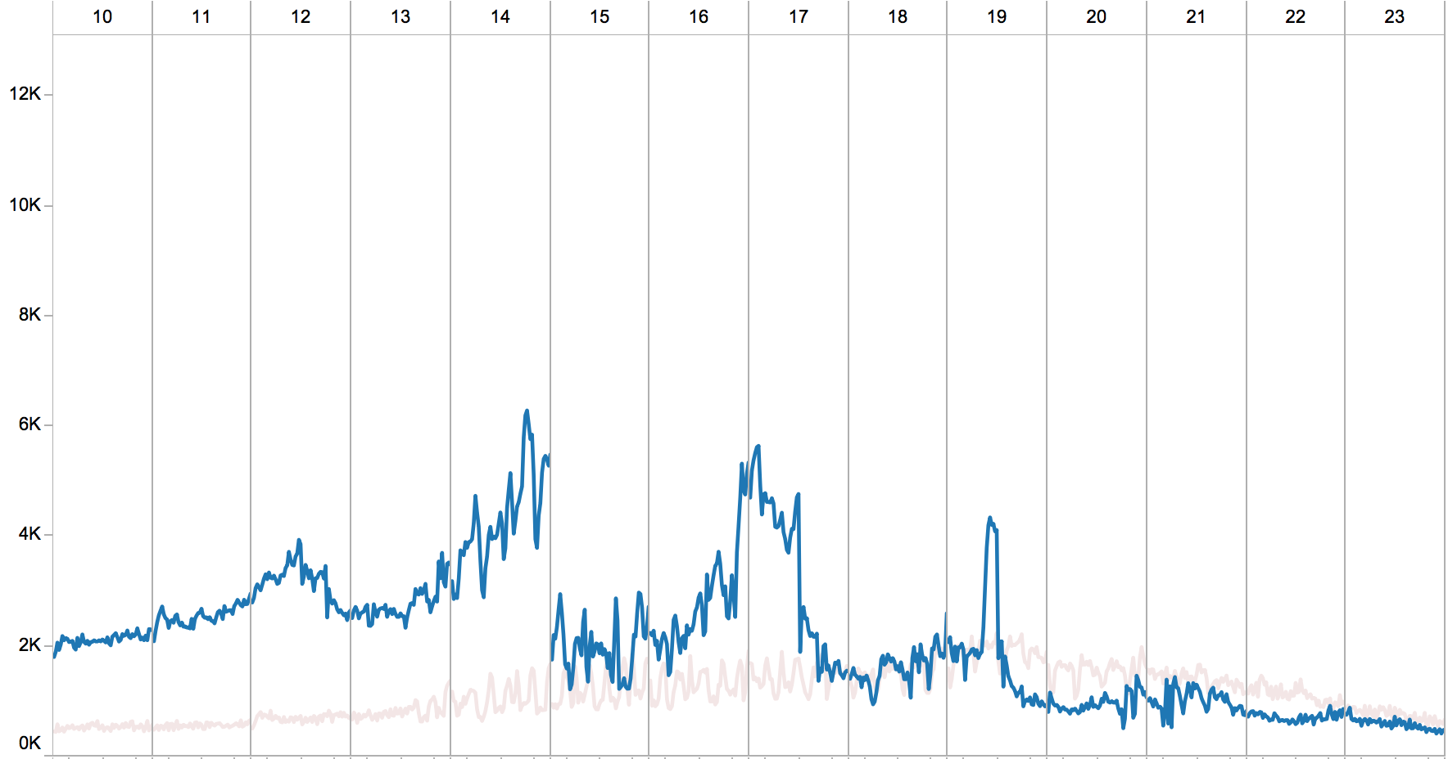
A normal Saturday
Notes:
Here’s what a regular Saturday’s traffic looks like.
Notice the football start and end, and then the late football match start and end.

Slide 7
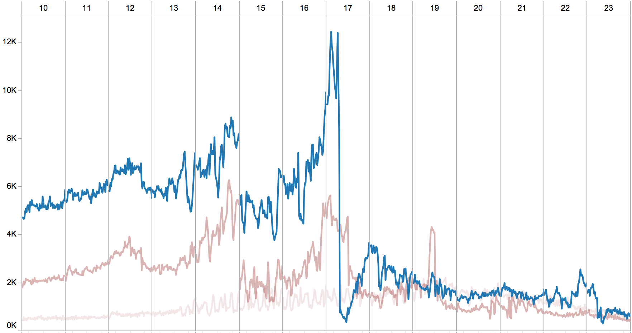
Grand National day
Notes:
And here’s Grand National.
Notice the football shape still happening, but uplifted a lot more.
Also the sharp drop as the Grand National itself starts
then the progressive recovery of traffic as we controlled the post-race thundering herd

Slide 8
Notes:
Who am I? Let’s understand a little about how SB&G is organised…

Slide 9









Account / SSO
Infrastructure
Data analytics
… and others
Notes:
SB&G is arranged into several areas

Slide 10
Account / SSO
Infrastructure
Data analytics
… and others
Notes:
I work in the ”Bet Tribe”, where a “Tribe” is something like a self-contained business unit

Slide 11
The “Bet” Tribe
Technology
Product
Marketing
Notes:
The Bet Tribe is not only Technology – it includes Product and Marketing as well.

Slide 12
The “Bet” Tribe - Technology
Architecture
Engineering
Operations
Notes:
Within Technology, we are grouped into 3 areas…

Slide 13
The “Bet” Tribe - Technology
Architecture
Engineering
Operations
Squad
Squad
Squad
Squad
Notes:
… although delivery teams cut across all areas.
Moving forwards, we’re trying to change it from just “delivery” into “ownership” – note that Operations is included here.

Slide 14
The “Bet” Tribe – Technology - Operations
Web Ops
Site Reliability Engineering
Platform Engineering
Service Management
Notes:
Within the Operations world, we have 4 teams
We look after the 24x7 site.

Slide 15
Notes:
SB&G is a rapidly growing business, and has been for several years now.
We used to be wholly-owned by Sky, but just over a year ago they sold 80% of us to a private VC company.
That gave us a lot of autonomy in how we operate, but it also made our first Grand National as an independent company a very high profile event in the eyes of our new owners.

Slide 16
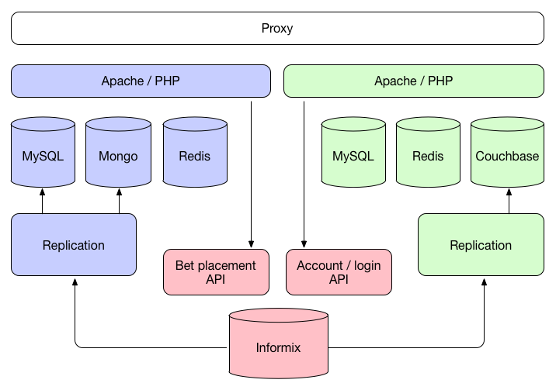
Sky Bet Architecture
Notes:
Architecturally, our betting site works in a traditional multi-tiered setup.
Website runs on PHP, behind proxies which do no caching.
Behind the PHP there's a few databases - MySQL and Mongo, as well as Redis for session and betslip storage (our betslip is a bit like an ecommerce shopping cart).
If you want to place a bet or do anything transactional, then we call APIs into another system which, although we don't develop that ourselves, we do host it as part of our technology stack and we manage and scale it ourselves alongside the website.
Notice the single Informix database behind it all. Scaling yay!
We also run a whole replication system, which uses NodeJS and RabbitMQ to get the catalog of sporting events and betting odds out of the backend and into the website's databases.

Slide 17
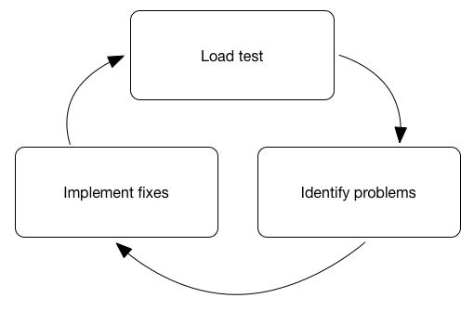
Load test cycle
Notes:
Preparation generally starts after Christmas, with a series of iterative cycles:
Load test key areas
Identify potential improvements
Plan and implement the improvements
HOWEVER… your load tests are lying to you.

Slide 18
Notes:
DON’T BELIEVE A LOAD TEST.
You will never ever ever replicate real traffic.
You need to use your experience to identify "key areas", and never think that the numbers you achieve in a load-test are representative of real life.

Slide 19
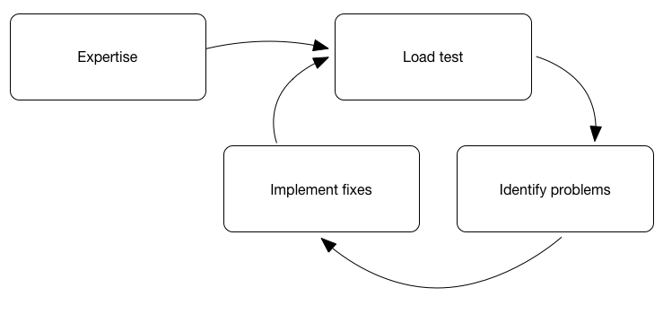
Load test cycle
Notes:
Use your experience in every step of the cycle.
Some things we found whilst load-testing…

Slide 20
Problems found in load testing
NFS performance
Account API memory leak
Virtual CPU layout issue
and… performance of the load injectors
Notes:
However, not everything is predictable…

Slide 21
Load tests only tell you about things you’re expecting
If the world was predictable, there wouldn’t be a betting industry…

Slide 22
Unexpected events…
Leicester City wins the Premier League
Horse races get cancelled
Competitor websites fail

Slide 23
Unexpected failures
Payment gateways fail
Banks fail
Identity verification services fail
Network transit links fail
Storage backends (e.g. SANs) fail
ISPs fail
Customer services systems fail
Notes:
More unexpected events
But worse than these failing, is…

Slide 24
Unexpected failures
Payment gateways fail
Banks fail
Identity verification services fail
Network transit links fail
Storage backends (e.g. SANs) fail
ISPs fail
Customer services systems fail
Slowing down is
worse than failing!
Notes:
… them slowing down.
For additional excitement…

Slide 25
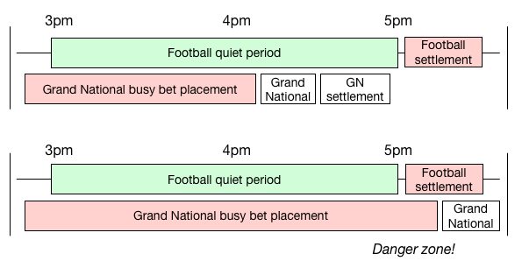
Grand National timeline
Notes:
… this year they chose to change the start-time of the race, introducing a database-killing danger zone into the mix.
To throw another unknown into the mix, last year we also made a lot of changes to our Accounts / SSO team; here’s Phil to tell you more.

Slide 26
The day itself
Notes:
On the day itself, we did two things which were particularly important to us surviving.

Slide 27
Two important things
Have a plan
Have a good team
Notes:
We knew that the plan wouldn't be stuck to, but it was useful to have a list of the un-movable parts of the day
horse race starts
football kick-offs and half- and full-times
expected settlement times etc.
Basically, a paper list of things which I could tick off as the day unfolded, and quickly reference if we saw any unexpected behaviour.

Slide 28
Two important things
Have a plan
Have a good team
… and let them do their job
Notes:
Please let your teams do their jobs.

Slide 29
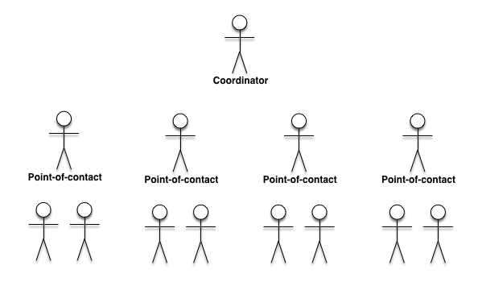
Team structure
Notes:
More importantly, though, was having clusters of small autonomous teams spread throughout the office but all within a sight-line (and hearing range) of a single central point (which was me).
Obviously, Sheffield weren't within hearing range of Leeds, but Phil acted as a proxy and was constantly on a video-call with the rest of the Account team in Sheffield, so as far as I was concerned Phil "was" the Sheffield office.

Slide 30
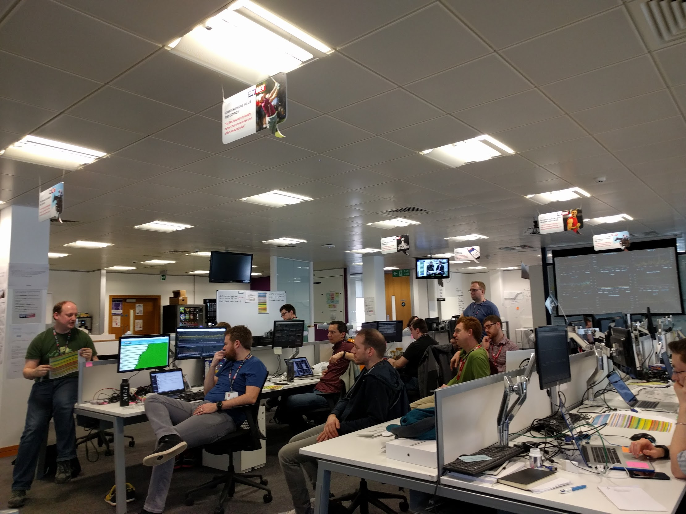
Office layout

Slide 31
Team structure
Web servers
Databases
Trading systems
Network
Storage
Compute power
Account
etc
Notes:
It's important to call out the autonomous nature of the teams.
We had teams of 2-4 people looking after things like

Slide 32
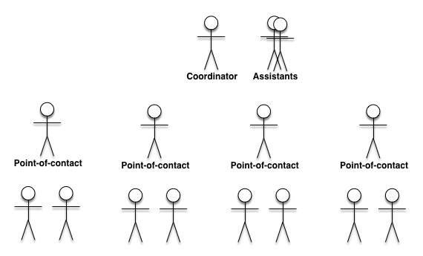
Team structure
Notes:
I also had assistants for:
Service management and non-technical business communication
Recording everything which was happening, decisions made, incidents etc
Taking over the coordination from me when I needed a break

Slide 33
So, what went wrong?
Notes:
Remember when I said that load-testing doesn't work...?
A couple of things very nearly went wrong on the day, but our teams noticed the potential problems and got out in front of them to put a fix in place.

Slide 34
Risk-management system
Notes:
For example, one of our risk management systems (which lets our traders see a filtered list of all bets going through the system) nearly took out our ability to take bets.

Slide 35
Risk management system
New = “Orwell”
Notes:
We have 2 versions of this risk management system – a new one (“Orwell”) …

Slide 36
Risk management system
New = “Orwell”
Old = “Not cool enough
to have a name”
Notes:
… and an old one which isn’t cool enough to have a name.

Slide 37

Risk management system
New = “Orwell”
Old = “Not cool enough
to have a name”
Notes:
Traders should be using Orwell, but In the run-up to the 3pm football kick-offs, Orwell hiccuped with the volume of bets going through it.
As a result, all of the traders launched the old system, which was the known fallback for Orwell.

Slide 38
Risk management system
New = “Orwell”
Old = “Not cool enough
to have a name”

Slide 39
Risk management system
New = “Orwell”
Old = “Not cool enough
to have a name”

Slide 40
Risk management system
New = “Orwell”
Old = “Not cool enough
to have a name”
Notes:
Unfortunately, the way the old system works means that the more people who launch it during high-volume bet-placement periods, the more it starts to crumble.
To make matters worse, one of the reasons why we've replaced the old system is because it's directly in line with bet-placement.
If it slows down, so does our bet placement capability.
The team looking after the trading systems noticed this, and realised that the Orwell hiccup had caused lots of people to launch the old system. After a quick conversation with me and our infrastructure team, they quickly scaled-up the Orwell platform …

Slide 41
Risk management system
New = “Orwell”
Old = “Not cool enough
to have a name”

Slide 42
Risk management system
New = “Orwell”
Old = “Not cool enough
to have a name”
Notes:
… opened the firewall to the new servers, put them into the load-balancer, and told the traders to go back to using Orwell instead of the old system.

Slide 43
Risk management system
New = “Orwell”
Old = “Not cool enough
to have a name”

Slide 44
Risk management system
New = “Orwell”
Old = “Not cool enough
to have a name”

Slide 45
Risk management system
New = “Orwell”
Old = “Not cool enough
to have a name”
Notes:
Bet placement remained unaffected.

Slide 46
Redis memory usage

Slide 47
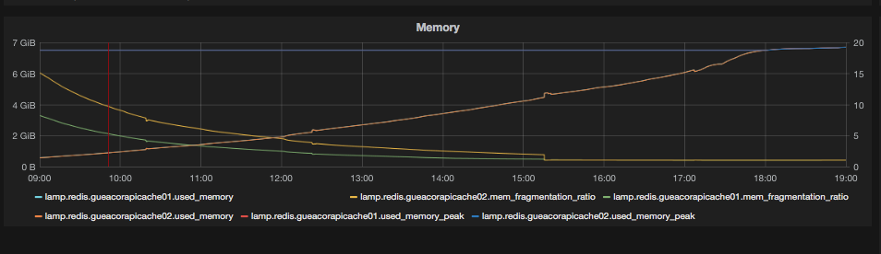
Redis

Slide 48
What happened during the danger zone?

Slide 49
Grand National day
Notes:
It was some of the best business we did all day.
Zooming in on the danger zone…

Slide 50
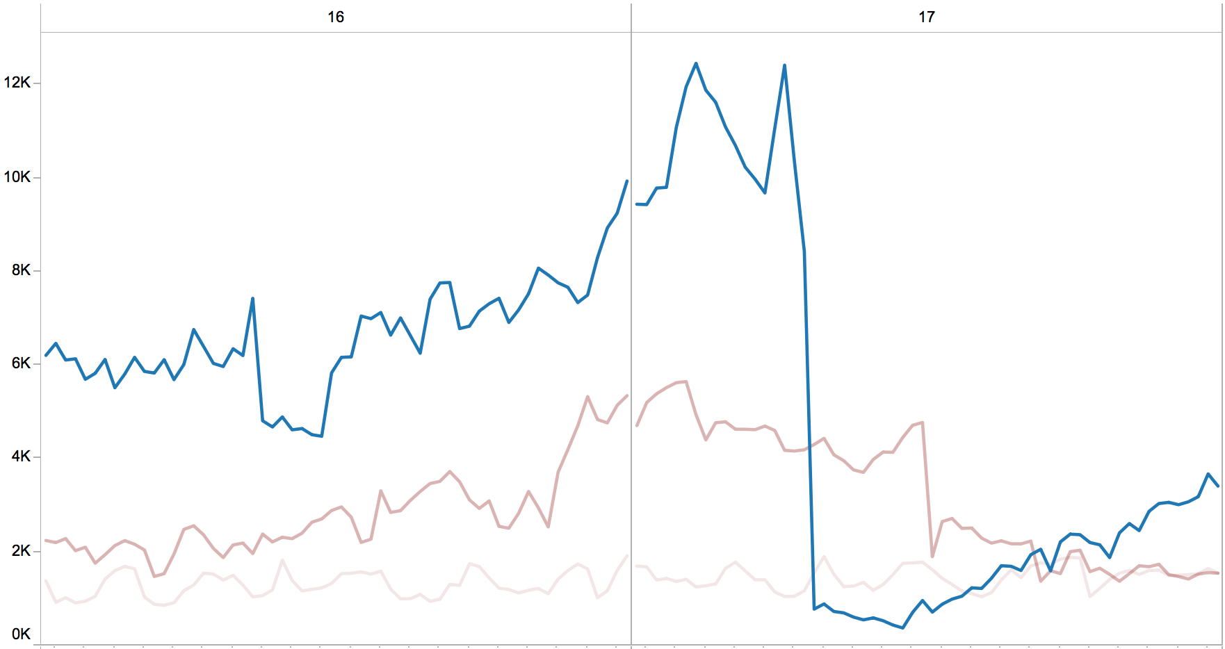
Grand National day
Notes:
… there are 3 uplifts, and each of these is related to our phased approach to football settlement, which is how we protected our database.
One of our largest competitors tweeted afterwards that they’d seen a record-breaking 9,779 bets/minute on the day – our management of the danger zone pushed us well above that for 20 mins or so.

Slide 51
Lessons learnt
Small teams
Trust your teams
Small, fast decision-making chain
Notes:
Crucially, there were a small number of people in the decision-making chain, and we had the right people in the right place to enact changes.

Slide 52
Lessons learnt
Small teams
Trust your teams
Small, fast decision-making chain
Everyone likes a successful day!
Notes:
Also... everyone went home at the end of day feeling good about themselves.

Slide 53
Thanks for listening!
Image credits:
“Grand National in Leeds”: Tom Hudson

